Slide 1
Travel explorer website
CAPSTONE PROJECT
Presented By:
Abhinav Sandiri-MVSR Engineering College-CSE

Slide 2
OUTLINE
Problem Statement
System Development Approach
Algorithm & Deployment
Result
Conclusion
Future Scope
References

Slide 3
Problem Statement
Planning trips can be overwhelming without easy access to reliable information.
Travelers struggle to explore destinations, view images, and check weather in one place.
Existing solutions are either too complex or scattered across different platforms.
Lack of a simple interface for browsing destinations efficiently.
Need for a lightweight, interactive, and user-friendly trip planning tool.

Slide 4
System Approach
Frontend Technologies:
HTML5 → Structure of web pages
CSS3 → Styling, layouts, responsive design
JavaScript → Interactivity, search, filters, modals, weather API
Design Approach:
Clean and intuitive UI
Grid-based destination cards
Modal galleries for photos
Mobile-responsive interface

Slide 5
Algorithm & Deployment
Step 1: Create data structure for destinations (name, country, images, description).
Step 2: Build layout using HTML & CSS (cards, grid, sidebar).
Step 3: Implement JavaScript features: search, filter, modal, weather API integration.
Step 4: Test responsiveness across devices and browsers.
Step 5: Deploy on GitHub Pages or Netlify for free hosting.
Step 6: Connect OpenWeatherMap API for real-time weather.

Slide 6
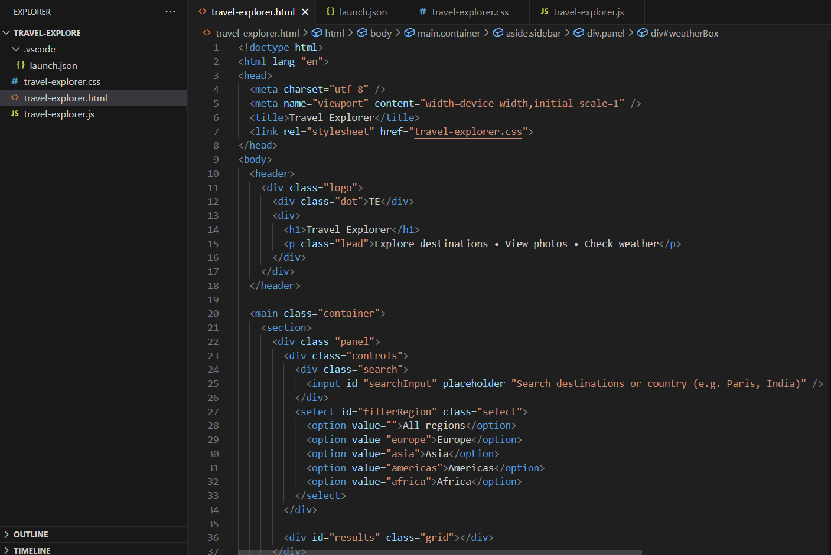
Result

Slide 7
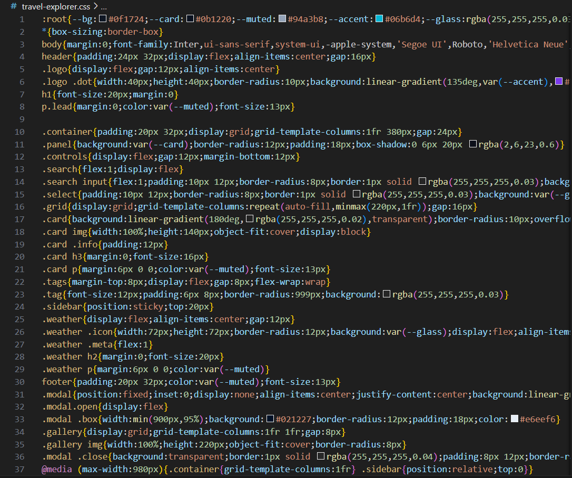

Slide 8
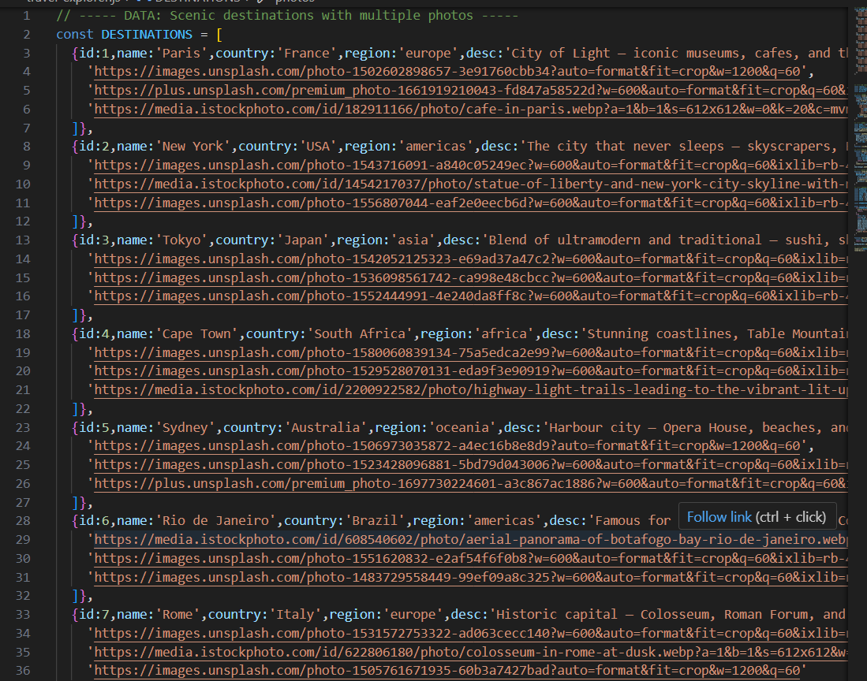

Slide 9
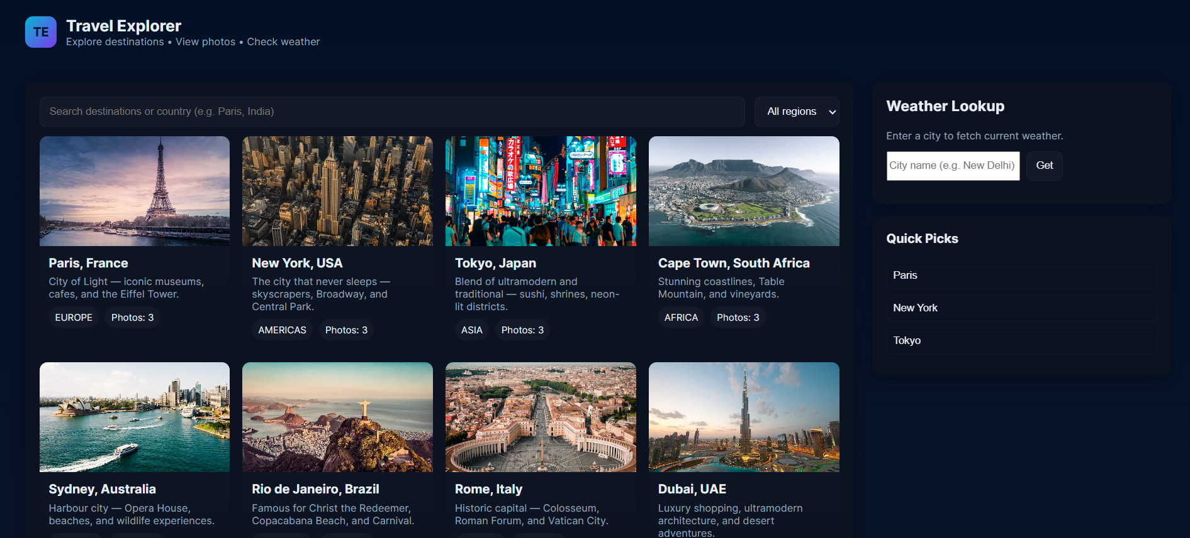

Slide 10
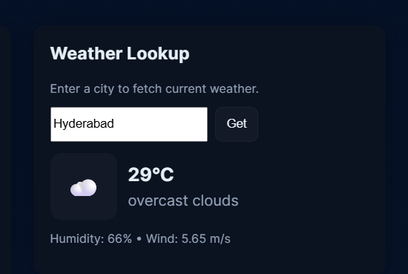

Slide 11
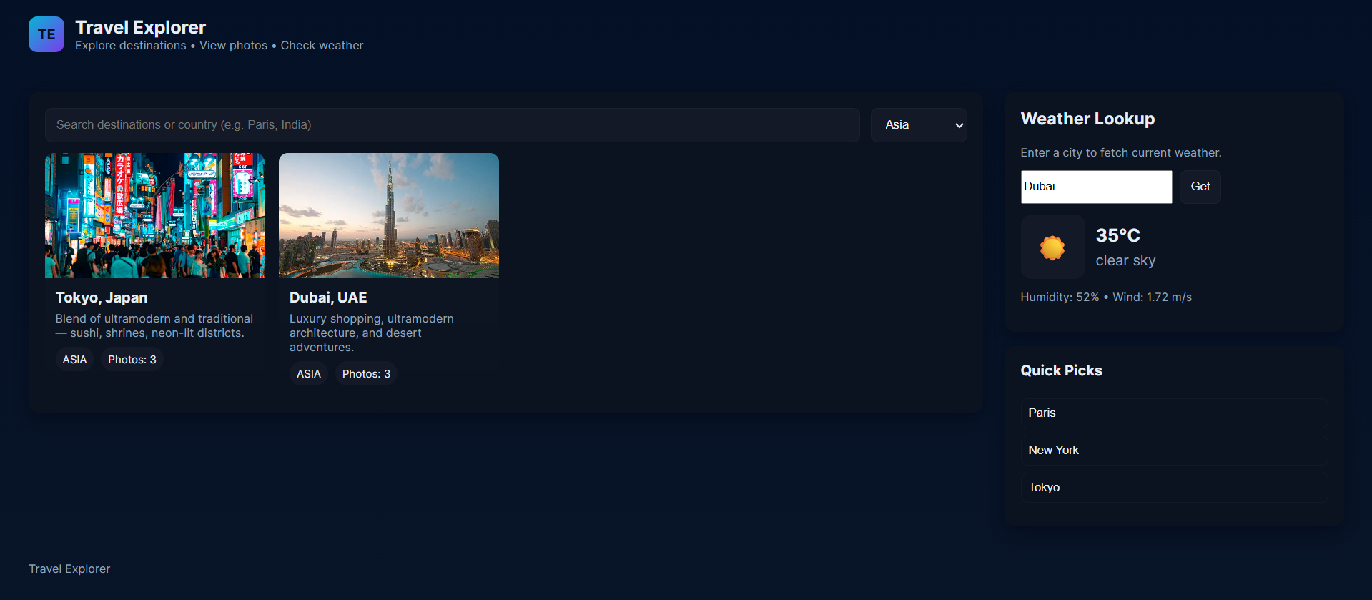

Slide 12
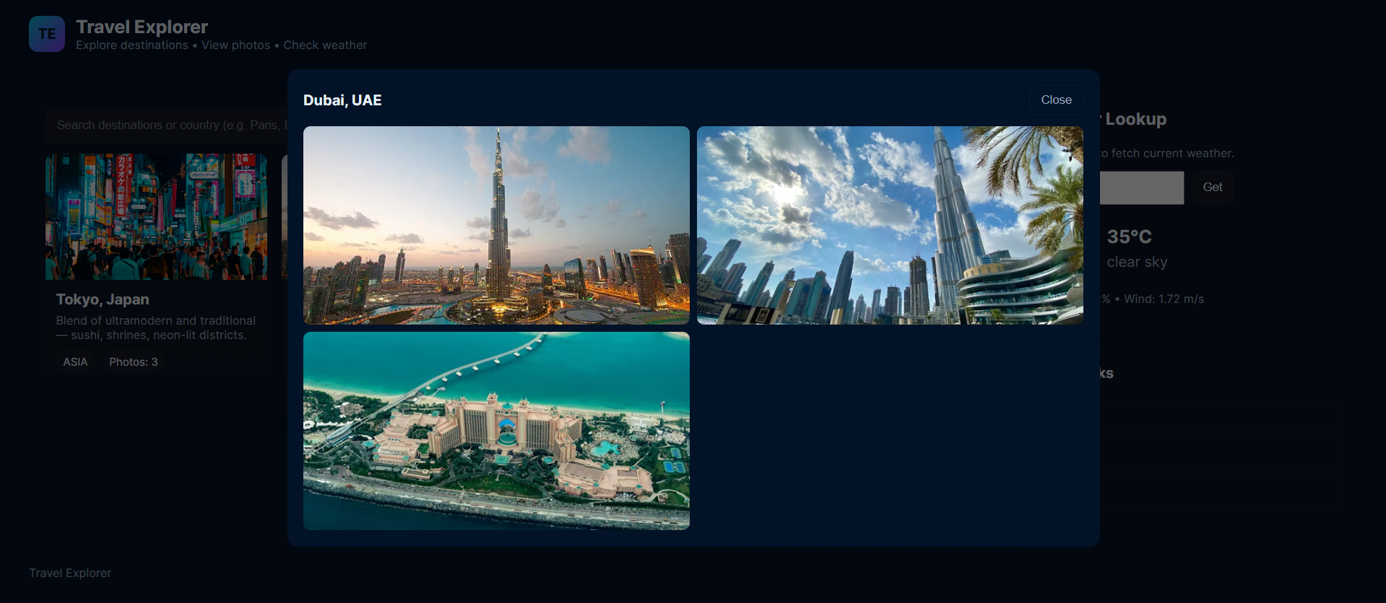

Slide 13
Github Link:
https://github.com/abhinavsandiri28/Travel-Explorer-Website

Slide 14
Conclusion
Provides a simple, engaging platform for travel planning.
Combines destination details, images, and live weather in one place.
Eliminates the need to juggle multiple apps or websites.
Boosts productivity and decision-making for travelers.
Can be easily extended with more destinations or features.

Slide 15
Future scope(Optional)
Add more destinations and richer photo galleries.
Integrate itinerary builder for day-to-day planning.
Connect APIs for hotel/flight booking.
Add AI-based travel recommendations.
User accounts with favorites and saved trips.
Multi-language support for global accessibility.

Slide 16
References
OpenWeatherMap API – for weather data.
Unsplash – free high-quality travel photos.
MDN Web Docs – HTML, CSS, and JavaScript references.
GitHub / Netlify – free hosting solutions.

Slide 17
THANK YOU

